Slide 1
Data Analytics Task 2 Exploratory Data Analysis (EDA) Presented By Victor Chukwuma Nwabufo STUDENT ID: CA/SE1/12728

Slide 2
Task 2
Ask meaningful questions about the dataset before analysis.
Explore the data structure, including variables and data types.
Identify trends, patterns and anomalies within the data.
Test hypotheses and validate assumptions using statistics and visualization.
Detect potential data issues or problems to address in further

Slide 3
Exploratory Data Analysis (EDA)
Exploratory data analysis has been promoted by John Tukey since 1970 to encourage statisticians to explore the data and possibly formulate hypotheses that could lead to new data collection and experiments. According to IMB Exploratory Data Analysis (EDA) is used by data scientists to analyze and investigate data sets and summarize their main characteristics, often employing data visualization methods. EDA helps determine how best to manipulate data sources to get the answers you need, making it easier for data scientists to discover patterns, spot anomalies, test a hypothesis, or check assumptions. EDA is primarily used to see what data can reveal beyond the formal modeling or hypothesis testing task and provides a better understanding of data set variables and the relationships between them. It can also help determine if the statistical techniques you are considering for data analysis are appropriate.
Also, Wikipedia defines Exploratory Data Analysis (EDA) as an approach of analyzing data sets to summarize their main characteristics, often using statistical graphics and other data visualization methods.
.

Slide 4
As for me, EDA is a systematic approach that a Data scientist or analyst must engage in to identify the patterns, anomalies, outliers, structures, and trends within a given dataset for him/her to make adequate hypotheses and visualization of the data by asking meaning questions and making in-dept analysis of a given dataset. It is essential that the investigation is carried out for good output of data analysis anticipation, communicating meaningful information to the department for further decision-making based on the analysis.
The figure A below shows the Data Science Process flowchart. The initial stage is that data are been collected from company’s activities, organization businesses or engagements, staffing among other means via data could be collect using different means like surveys, and interviews. This data collected would then been processed become what we called clean Dataset. It then moves either for modelling and algorithms or EDA stage. EDA is where proper analysis is done to check for anomalies, outliers, trends, structures, and pattern in the dataset which moves to models and algorithms after analysis. Data product happens after and communicate visualize report for decision making

Slide 5

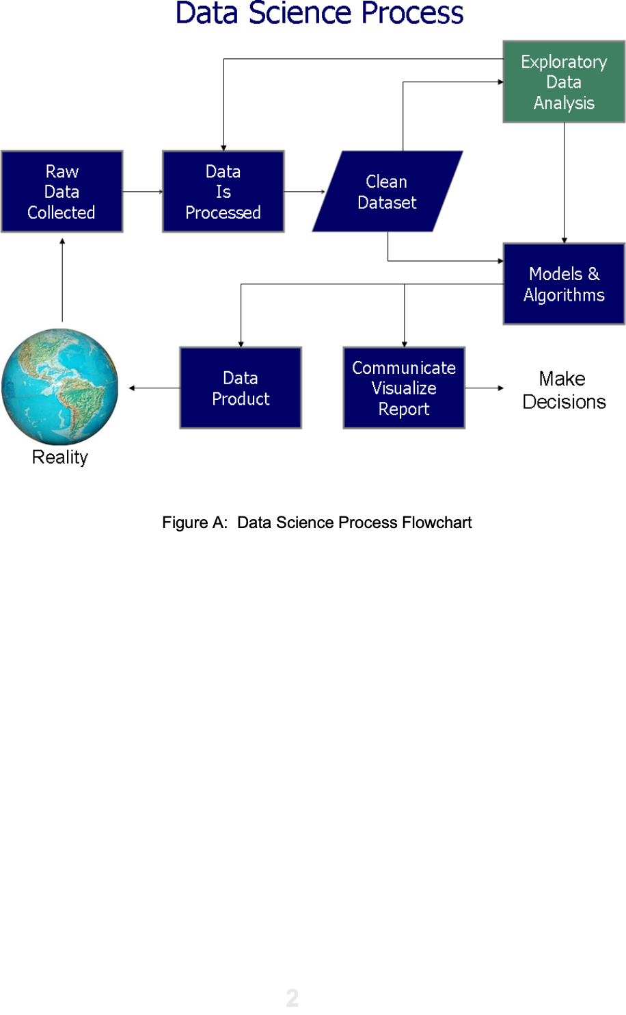

Slide 6
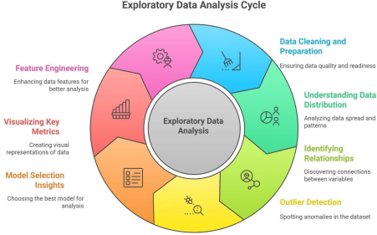
Figure B

Slide 7
Figure B above: Steps for mastering Exploratory Data Analysis (EDA)
In the figure B above, it is important for easy mastering of EDA. The data analyst would follow this cycle adequately to handling any given dataset for easy data analysis and reporting. These include data cleaning and preparation, understanding data distribution, identifying relationships, outliers’ detection, model selection insights, visualizing key metrics and features engineering.
Once data analyst becomes conversant with this EDA cycle there no kind of datasets, he/she
would not be able to adequately analyzed and report needful information to the organizational heads for further decision making.
How EDA Can be Performed with Code
EDA can be performed using various programming languages, but Python is one of the most popular choices due to its powerful libraries like Pandas, Matplotlib, and Seaborn. Here's how EDA can be performed with code:
Importing Necessary Libraries
First, you need to import the essential Python libraries for data manipulation and visualization:

Slide 8
# 1--- Import libraries ---
import pandas as pd
import numpy as np
import matplotlib.pyplot as plt
import seaborn as sns
from sklearn.decomposition import PCA
Explanations:
Import the Pandas library, used for handling and analyzing data (especially tables and CSV files)
The as pd part means you can use the short name pd instead of typing pandas every time.
Import the NumPy library for numerical computations and working with arrays (multi-dimensional data)
Import the Pyplot module from the Matplotlib library. Used for creating visualizations like line charts, bar charts, and histograms.
Import the Seaborn library, which builds on top of Matplotlib. It makes it easier to create beautiful and informative statistical graphics.
Import the PCA (Principal Component Analysis) class from Scikit-learn’s decomposition module.
PCA is a dimensionality reduction technique — it helps simplify complex datasets by reducing the number of variables while keeping most of the information.

Slide 9
Loading the Dataset
Load the dataset into a Pandas DataFrame:
# 2. To mount the drive
from google.colab import drive
drive.mount('/content/drive')
Explanations:
This code connects your Google Drive to your Colab notebook so you can easily load datasets and save outputs directly between the two environments.
This connection allows Colab to read and write files (like datasets, notebooks, or results) stored in your Google Drive.
# 3. Load the Iris dataset from the internet
url = "https://archive.ics.uci.edu/ml/machine-learning-databases/iris/iris.data"
columns = ['sepal_length', 'sepal_width', 'petal_length', 'petal_width', 'species']
df = pd.read_csv(url, header=None, names=columns)
print(df.head())
Explanations:
This code downloads the Iris dataset from the internet, labels its columns, loads it into a Pandas DataFrame, and shows the first few rows. print (df.head( ))
Displays the first 5 rows of the DataFrame to quickly preview the data.
# 3. Load the Iris dataset from the Google Drive thus iris.csv file
data = "/content/drive/MyDrive/CodeAlpha/iris.csv"
df = pd.read_csv(data)
print(df.head())
.csv file from Google Drive into a Pandas DataFrame and shows the first few rows of the data.
Uses Pandas to read the CSV file located at that path.Loads the data into a DataFrame named df. Prints the first 5 rows of the DataFrame so you can preview the dataset.

Slide 10
Basic Data Overview
Get a quick overview of the data using basic functions:
#4 ---- Basic overview ---
# Display the first few rows of the dataset
print(df.head())
# Get a summary of the dataset (data types, non-null counts, column information)
print(df.info())
# Get the summary of statistics of numerical columns
print(df.describe())
Explanations:
These commands give you a quick overview of your dataset — its content, structure, and key statistics.
Handling Missing Values
Check for missing values and decide on a strategy to handle them (e.g., removing or imputing):
#5 ---- Handling missing values ----
# check missing values
print(df.isnull().sum())
Explanations:
This code counts and shows the number of missing values in up to the first 20 columns of the DataFrame.

Slide 11
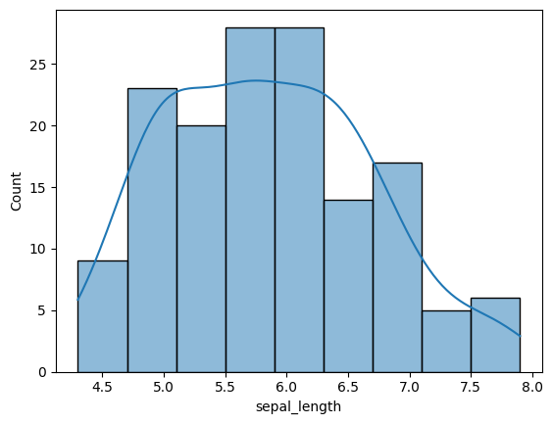
# Histogram of a single variable
sns.histplot(df['sepal_length'], kde=True)
plt.show()

Slide 12
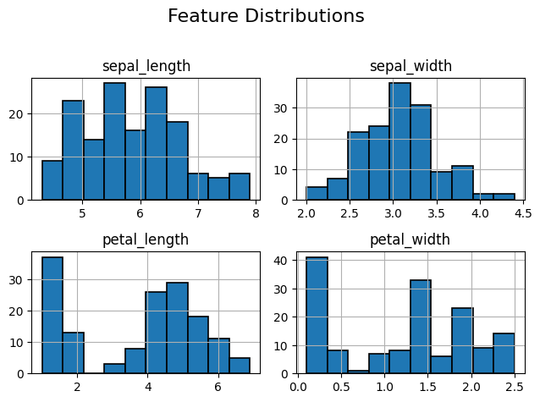
Univariate Analysis
Analyze individual variables:
# 6. Distribution of Features
plt.figure(figsize=(10, 8))
df.hist(edgecolor='black', linewidth=1.2)
plt.suptitle('Feature Distributions', fontsize=16)
plt.tight_layout(rect=[0, 0, 1, 0.96])
plt.show()
Explanations:
Plots histograms for all numerical columns in the DataFrame.
This code creates and shows histograms to visualize how each feature in the dataset is distributed.

Slide 13
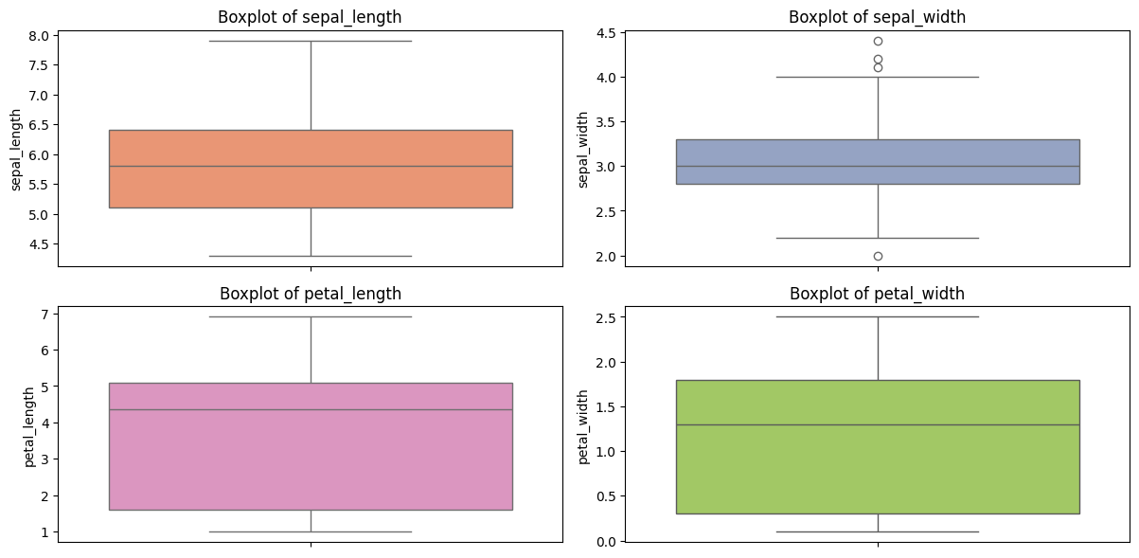
# 7. Boxplots to check for outliers
plt.figure(figsize=(12, 6))
for i, col in enumerate(df.columns[:-1], 1):
plt.subplot(2, 2, i)
sns.boxplot(y=df[col], color=sns.color_palette("Set2")[i])
plt.title(f'Boxplot of {col}')
plt.tight_layout()
plt.show()
Explanations:
This code creates boxplots for the first four numerical features in the dataset, arranged neatly in a 2×2 grid, to visualize their distributions and detect outliers.
Draws a boxplot for each column to show its data spread
and outliers.
Uses colors from Seaborn’s "Set2" palette for variety.

Slide 14
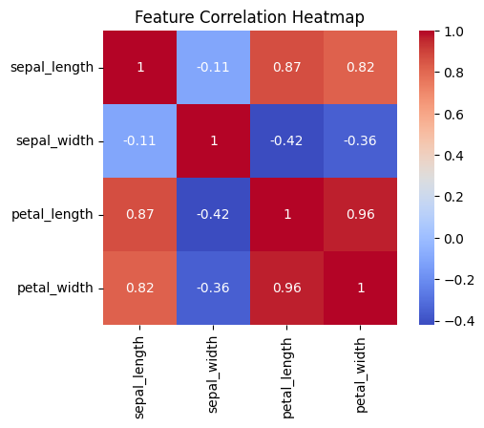
Bivariate Analysis
Examine relationships between two variables:
# 9. Correlation Matrix & Heatmap
# Remove rows with '...' in 'sepal_length'
df_cleaned = df[df['sepal_length'] != '...'].copy()
# Convert 'sepal_length' to numeric
df_cleaned['sepal_length'] = pd.to_numeric(df_cleaned['sepal_length'])
corr = df_cleaned.iloc[:, :-1].corr()
plt.figure(figsize=(6, 4))
sns.heatmap(corr, annot=True, cmap='coolwarm', square=True)
plt.title('Feature Correlation Heatmap')
plt.show()
Explanations:
This code cleans invalid data, computes correlations between numeric features, and visualizes them with a heatmap to show how strongly the features are related.
Plots a heatmap to visualize the correlation matrix.
annot=True → shows correlation values inside the boxes. cmap='coolwarm' → adds color to indicate positive/negative correlation. square=True → keeps cells square-shaped.

Slide 15
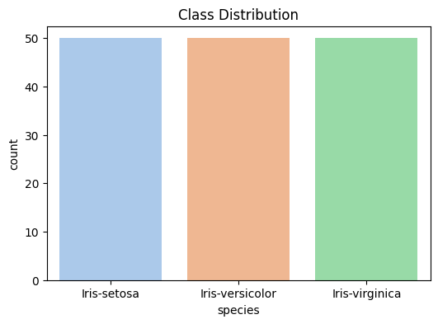
# 10. Species Distribution
plt.figure(figsize=(6, 4))
sns.countplot(x='species', data=df, palette='pastel')
plt.title('Class Distribution')
plt.show()
Explanations:
This code plots a countplot to show how many samples there are for each iris flower species in the dataset.
• Creates a bar chart showing the count of each species in the dataset. x='species' → species are on the x-axis. palette='pastel' → gives soft, pleasant colors

Slide 16
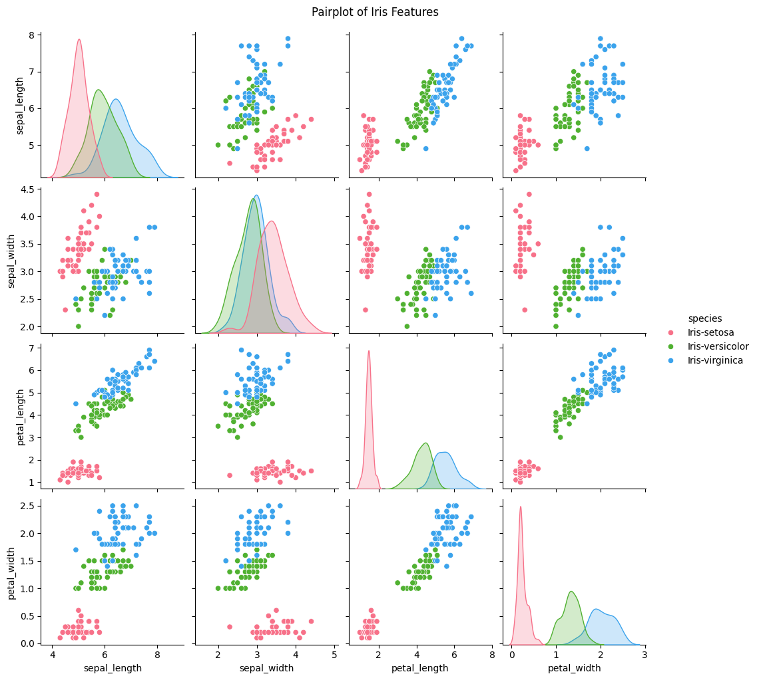
Multivariate Analysis
Explore relationships involving more than two variables:
# 8. Pairplot to visualize relationships
sns.pairplot(df, hue='species', diag_kind='kde', palette='husl')
plt.suptitle('Pairplot of Iris Features', y=1.02)
plt.show()
Explanations:
This code draws a pairplot to visualize how all iris flower features relate to each other, using color to distinguish species.

Slide 17
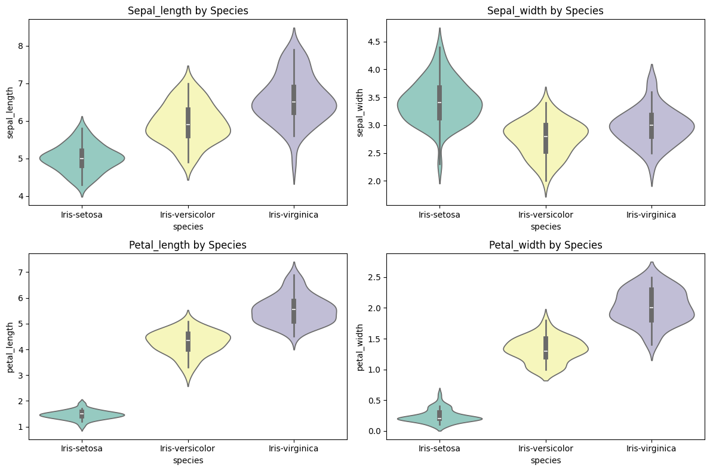
# 11. Violinplots for feature distributions by species
plt.figure(figsize=(12, 8))
for i, col in enumerate(df.columns[:-1], 1):
plt.subplot(2, 2, i)
sns.violinplot(x='species', y=col, data=df, palette='Set3')
plt.title(f'{col.capitalize()} by Species')
plt.tight_layout()
plt.show()
Explanations:
This code draws violin plots for each feature to
compare how their values are distributed across the
different iris species.
Creates a violin plot showing the distribution of
each feature (col) for each species.
palette='Set3' applies soft, distinct colors.

Slide 18
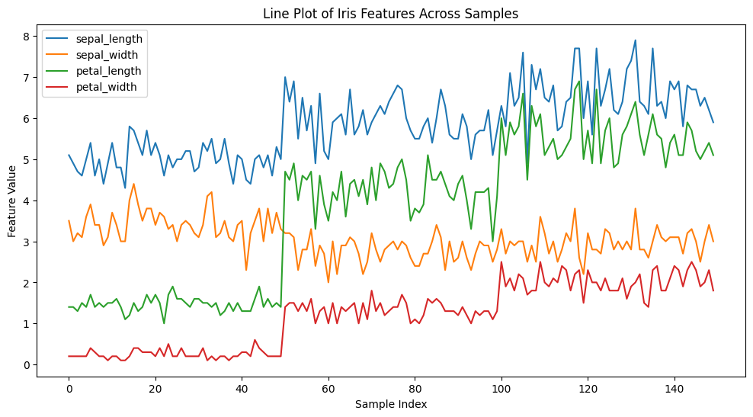
Identifying Patterns and Trends
Look for patterns or trends in the data:
# 14. Plot line plots for all features
plt.figure(figsize=(12,6))
for column in df.columns[:-1]: # Exclude the 'species' column
plt.plot(df.index, df[column], label=column)
plt.xlabel("Sample Index")
plt.ylabel("Feature Value")
plt.title("Line Plot of Iris Features Across Samples")
plt.legend()

Slide 19
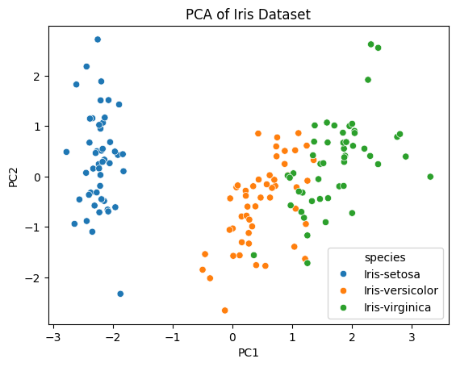
Dimensionality Reduction
If the dataset is large, techniques like PCA can help reduce dimensions:
#15 Reduce to 2 dimensions
from sklearn.preprocessing import StandardScaler
from sklearn.decomposition import PCA
import pandas as pd
import seaborn as sns
import matplotlib.pyplot as plt
X = df[['sepal_length','sepal_width','petal_length','petal_width']].values
X_scaled = StandardScaler().fit_transform(X)
pca = PCA(n_components=2)
principal_components = pca.fit_transform(X_scaled)
df_pca = pd.DataFrame(data=principal_components, columns=['PC1','PC2'])
df_pca['species'] = df['species']
sns.scatterplot(x='PC1', y='PC2', hue='species', data=df_pca)
plt.title('PCA of Iris Dataset')
plt.show()
PCA is useful here
Reduces 4-dimensional data to 2D or 3D for visualization.
Helps to see if species are separable in fewer dimensions.
Often, the first 2 principal components capture >95% of the variance, so little information is lost.

Slide 20
# 16. Summary of findings
print("\nSUMMARY:")
print("- The Iris dataset contains 150 samples with 4 features and 3 species.")
print("- No missing values detected in the dataset.")
print("- Some features show strong correlation in the dataset(like, petal_length and petal_width).")
print("- Feature distributions are generally well-separated by species, especially petal measurements.")
print("- Class distribution is adequately balanced across species.")
Explanations:
This code print out the summary of the findings
SUMMARY:
- The Iris dataset contains 150 samples with 4 features and 3 species.
- No missing values detected in the dataset.
- Some features show strong correlation in the dataset (like, petal_length and petal_width).
- Feature distributions are generally well-separated by species, especially petal measurements.
- Class distribution is adequately balanced across species.

Slide 21
Conclusion
Exploratory Data Analysis requires iterating between visual, and statistical techniques and domain knowledge to fully comprehend the data. Mastering EDA is key to extracting useful insights, formulating problems impactfully and overcoming challenges.
analysis
1. Missing values
Problem: Missing data can affect algorithms that don’t handle NaN values.
Check: df.isnull().sum()
Iris dataset: Usually no missing values in the standard dataset, but if modified, some entries might be missing.
Solution: Impute missing values (mean, median, mode) or remove rows if very few.
2. Outliers
Problem: Extreme values can skew results (especially for PCA, K-Means, or distance-based algorithms).
Check: Boxplots for each feature: import seaborn as sns.boxplot(data=df[['sepal_length','sepal_width','petal_length','petal_width']])
Solution: Investigate outliers; you may keep them (if genuine) or remove/transform them.
3. Feature scaling
Problem: Algorithms like PCA, K-Means, or SVM are sensitive to feature scales.
Check: Compare ranges of features; for Iris:
sepal_length ~ 4.3–7.9
sepal_width ~ 2.0–4.4
petal_length ~ 1.0–6.9
petal_width ~ 0.1–2.5
Solution: Standardize or normalize features before analysis.

Slide 22
4. Class imbalance
Problem: Unequal number of samples per species can affect classifiers.
Check: df['species'].value_counts()
Iris dataset: Balanced (50 samples each), so no issue here.
5. Correlation between features
Problem: Highly correlated features can affect PCA and some models.
Check: Correlation matrix: sns.heatmap(df.corr(), annot=True)
Observation: petal_length and petal_width are strongly correlated; PCA can help reduce redundancy.
6. Non-numeric features
Problem: Species labels are categorical; many ML algorithms require numerical encoding.
Solution: Use label encoding or one-hot encoding if needed.
7. Small dataset size
Problem: Only 150 samples; may not generalize well for complex ML models.
Solution: Suitable for learning and demonstration, but not for production-level predictive models.
Consider cross-validation to prevent overfitting.

Slide 23
8. Feature relevance
Some features may contribute more to class separation than others
(e.g., petal dimensions separate species better than sepal dimensions).
Solution: Feature selection or dimensionality reduction (like PCA) can help.
Summary: Even though Iris is clean, for further analysis you should:
Check for missing values and outliers.
Standardize features.
Handle categorical labels appropriately.
Consider correlations and feature relevance.
Be mindful of dataset size when modeling.
Summary of preprocessing steps
Load dataset.
Check for missing values.
Explore data statistics and ranges.
Detect and handle outliers.
Check feature correlations.
Separate features and labels.
Standardize numeric features.
Encode categorical labels (if needed).
Split dataset for training/testing (for ML).
Apply PCA for dimensionality reductio.
Visualization.

